Slide 1
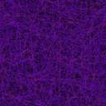
Bio Imaging Software
Q1 Proposals were made and are shown in white
Q2 Development is shown in Yellow
Q3 Further development shown in light blue

Slide 2
Bio Imaging Software Feature List

Slide 3
Proposed Features, reasons
Q1 State
Magnification Factor
Supplementary methods to enter magnification factor
Currently we rely on the accuracy of a high precision XY stage
Single image capture
Typical scanned area differences between silicon and bio samples
Focus stacking
Depth of field differences between semiconductor and bio samples
Video
Unlike semiconductors, bio samples may be dynamic: change or move

Slide 4
Newly Implemented Features
Q3 State
Magnification Factor
Calibration of Camera Angle, (extra feature, not originally planned)
Calibration of lens magnification from (i)a calibrated slide, or (ii)X axis
Single image capture
Captures a single image received from the camera,
No tile stitching required
No need to specify image size: uses region of interest (ROI)
Focus stacking
Combines images with different part in focus, into a single image
Video
Uses OpenCV VideoWriter class. Creates MPEG-2, MPEG-4 and M-JPEG files

Slide 5
Graphic User Interface
Changes required to control/use new features

Slide 6
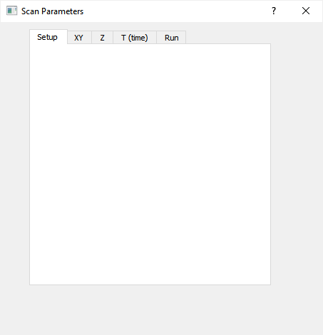
Scan Parameters
Tabbed approach
Q1 State: Proposed this
New capabilities added to the GUI
Prompts grouped into tabs
Only the relevant tabs will be operable
Inoperable may mean greyed out or not shown

Slide 7
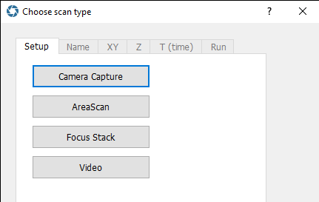
Scan Parameters
Tabbed approach
Q2 State: Implemented this
New capabilities added to the GUI
  Name tab added for saved image
Prompts grouped into tabs
  Setup, name, Z and Run tabs functioning
Only the relevant tabs are operable
Decision made: Inoperable means greyed out

Slide 8
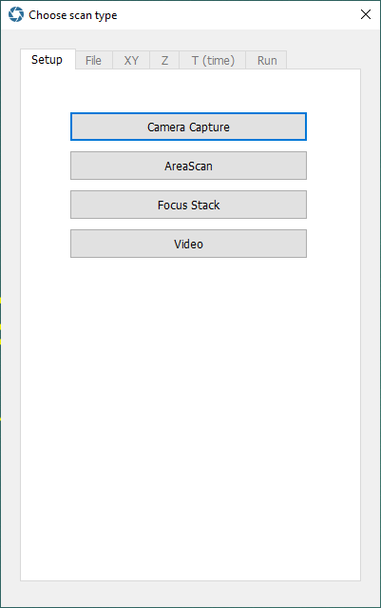
Single Image Capture
Q3: Developed
Simply captures the camera’s region of interest
Image saved identically to scanned images
Allows metrology tools to be used, i.e.
measurements
labels

Slide 9
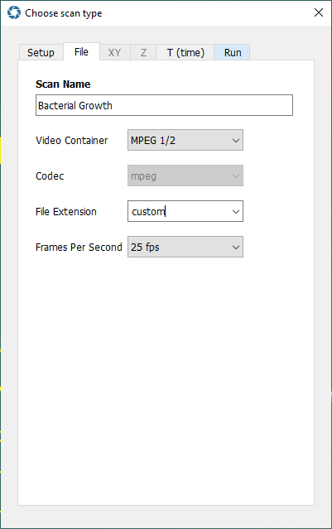
Scan Parameters
File
Q3 State: Implemented this
“Name” tab renamed to “File” tab…
MEDIA PROMPTS ARE ONLY SHOWN FOR VIDEO FILES!
... because video files require more info than just a name
Media files may “contain” multiple audio / video streams
Video streams may be encoded by different codecs for different formats, e.g. MPEG2, MPEG4, Motion JPEG
Various standard file extensions are used
Custom prompt values [discouraged] may be entered…
… potentially allowing customer installed codecs to be available for video creation.
Frames per second here is the proposed playback rate

Slide 10
Focus Stacking
Q2 State
Info: Images have a limited depth of field
Done: Capture multiple images of same location
Done: Each image focuses at a different depth (Z-axis)
Done: “In focus” part of each image selected
Done: New “all in focus” image created from the parts

Slide 11
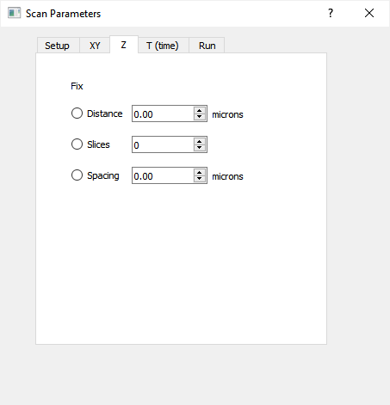
Scan Parameters
Z
Q1 State: Proposed this
There are three values to work with.
However there are just independent variables
The intent had been that adjusting a variable would automatically change another (keeping the third variable fixed)
This proved to be impractical to use, even by the author.

Slide 12
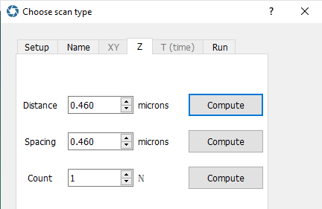
Scan Parameters
Z
Q2 State: Implemented this
CALCULATE buttons introduced.
These calculate a variable from the values entered for the other two
distance = spacing * count
For example clicking the highlighted button sets the distance value from the count and the spacing
The Run tab is disabled when the relationship is not met

Slide 13
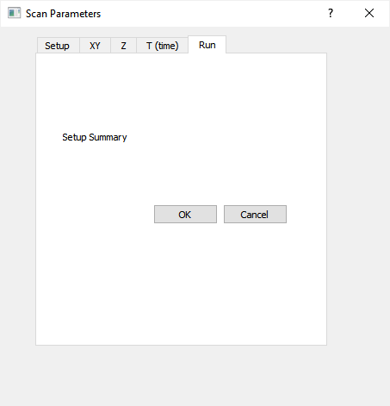
Scan Parameters
Run
Q1 State: Proposed this
A selected options summary is displayed
The user is free to verify all options are correct
The user may return to previous tabs and correct errors
The OK option starts the scan

Slide 14
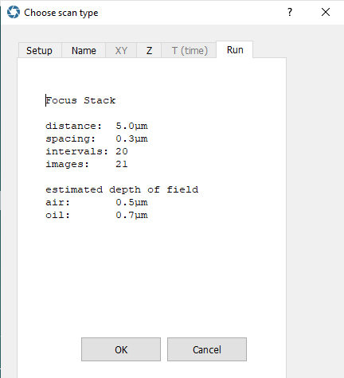
Scan Parameters
Run
Q2 State: Implemented this
A summary of the parameters entered is shown
This includes some supplementary information
For example the estimated depth of field

Slide 15
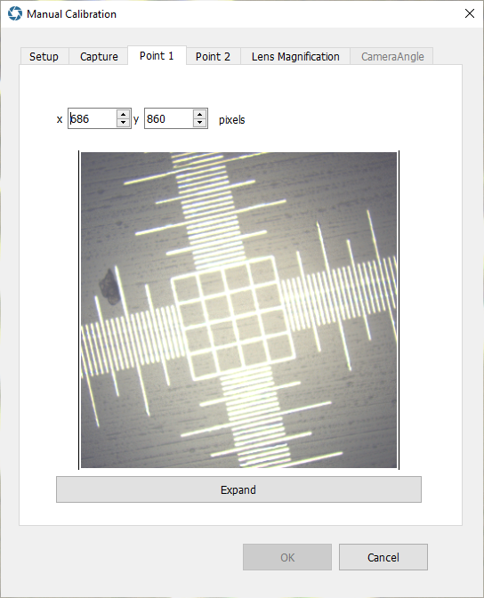
Manual Calibration
Q3: Developed
Setup allows choice of calibration methods
Capture snapshots camera images
Two points are selected, a known distance apart
Points are clicked and coordinates are shown
An expanded view allows greater precision
Lens Magnification is then calculated
With our SMAL lens, each pixel is about 12nm

Slide 16
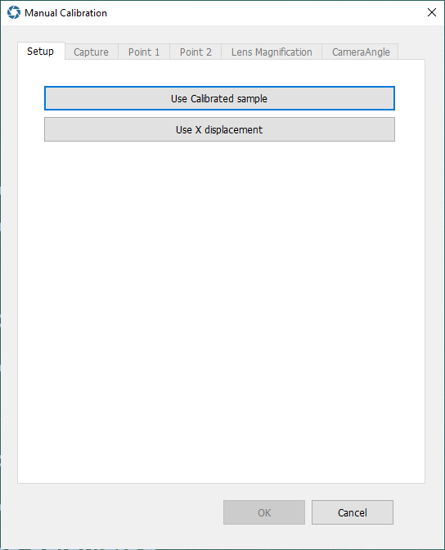
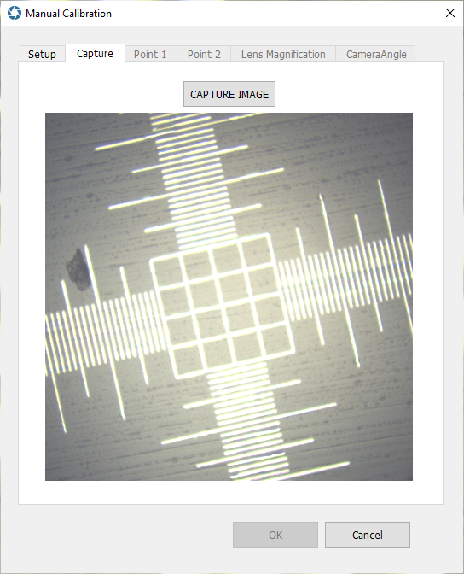
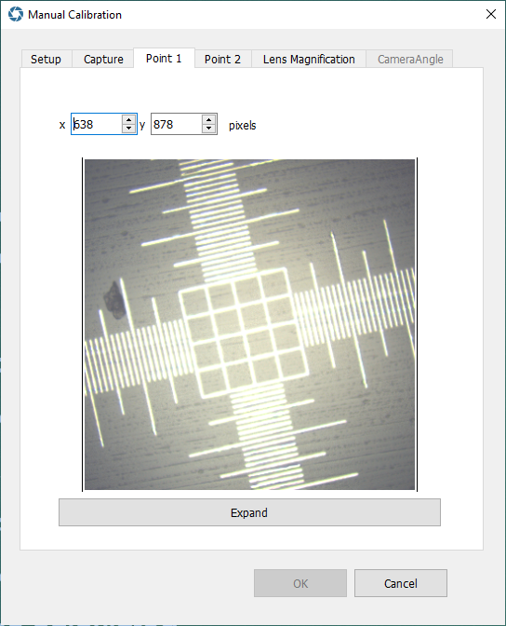
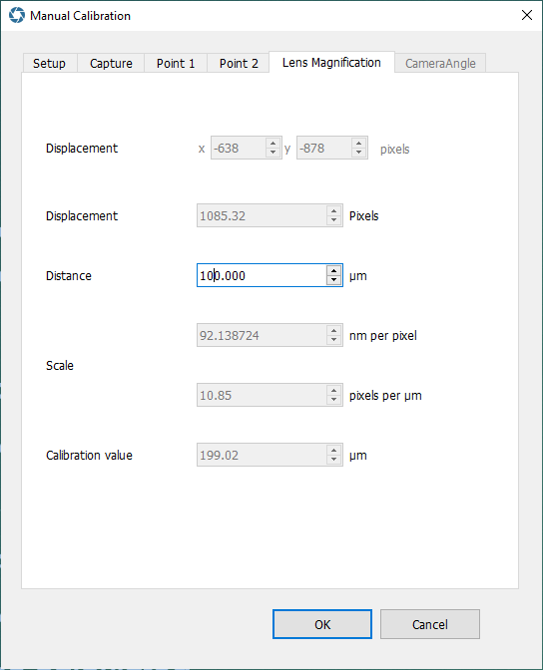
Manual Calibration
Q3: Developed
Setup allows choice of calibration methods
Capture snapshots camera images
Two points are selected, a known distance apart
Points are clicked and coordinates are shown
An expanded view allows greater precision
Lens Magnification is then calculated
With our SMAL lens, each pixel is about 12nm

Slide 17
Software Components
Changes required to provide new features

Slide 18
Focus Stacking Library based on open source software
Q1 State: Proposed this
Don’t reinvent the wheel
Command line interface to the software not required
Library created for use within the Nanoro software
Define library interface
Can replace library if improved focus stacking software found later

Slide 19
Focus Stacking Library based on open source software https://github.com/PetteriAimonen/focus-stack
Q2 State: Implemented this
Library created for use within the Nanoro software
focusstacklibrary.dll
class FocusStack contains useful functions from original program
Source code largely unaltered
Wrappers created to simplify use

Slide 20
Software Testing Results
DEMONSTRATING THE FEATURES IN OPERATION

Slide 21
Software Testing Results
FOCUS STACKING

Slide 22
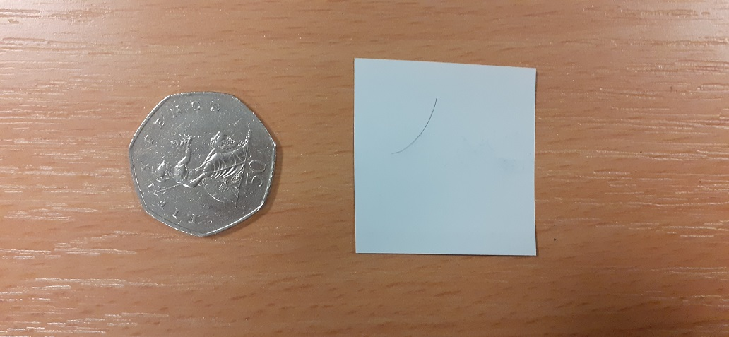
Human hair on paper
Photo from a mobile phone

Slide 23
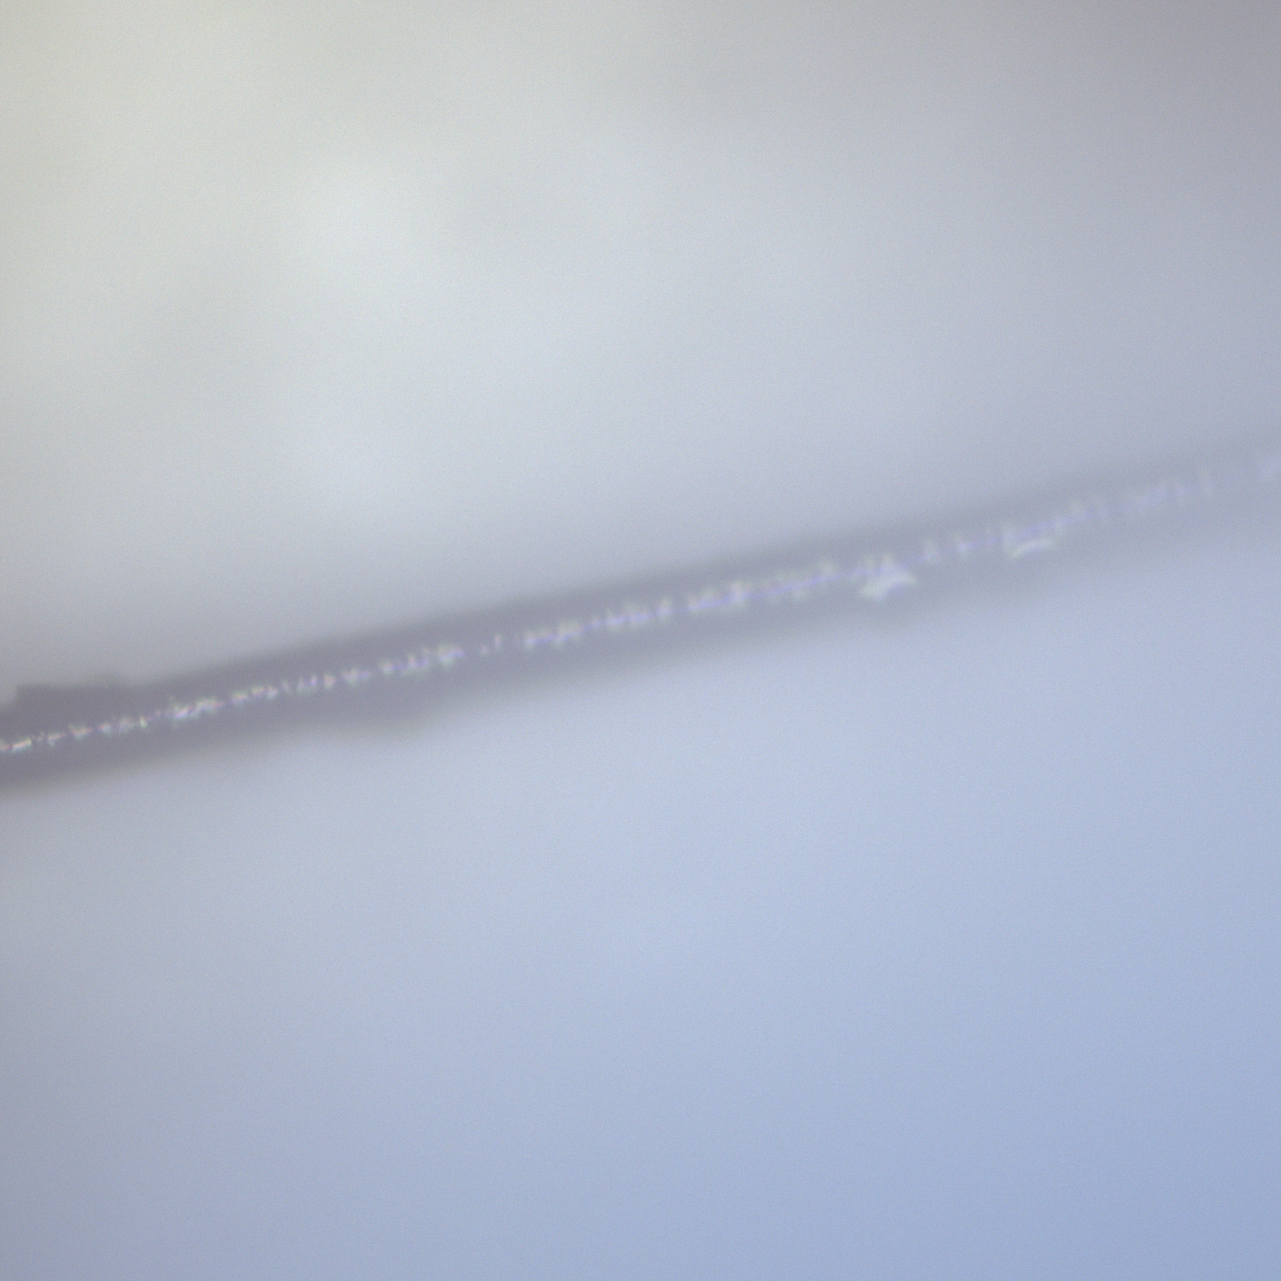
Human hair on paper
10x lens
25 steps used, 8μm apart, total distance 200μm
i.e. 26 images captured and used
This image focussed on the hair

Slide 24
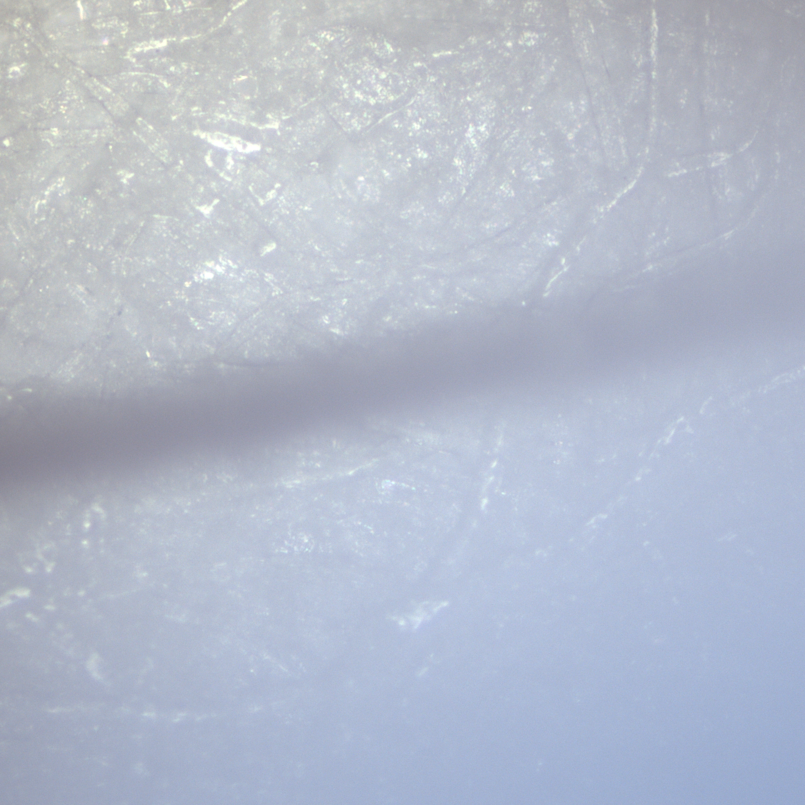
Human hair on paper
Same lens, same XY coordinates, different Z coordinate
Another of the 26 images from the Z-stack
This image is focussed on the paper

Slide 25
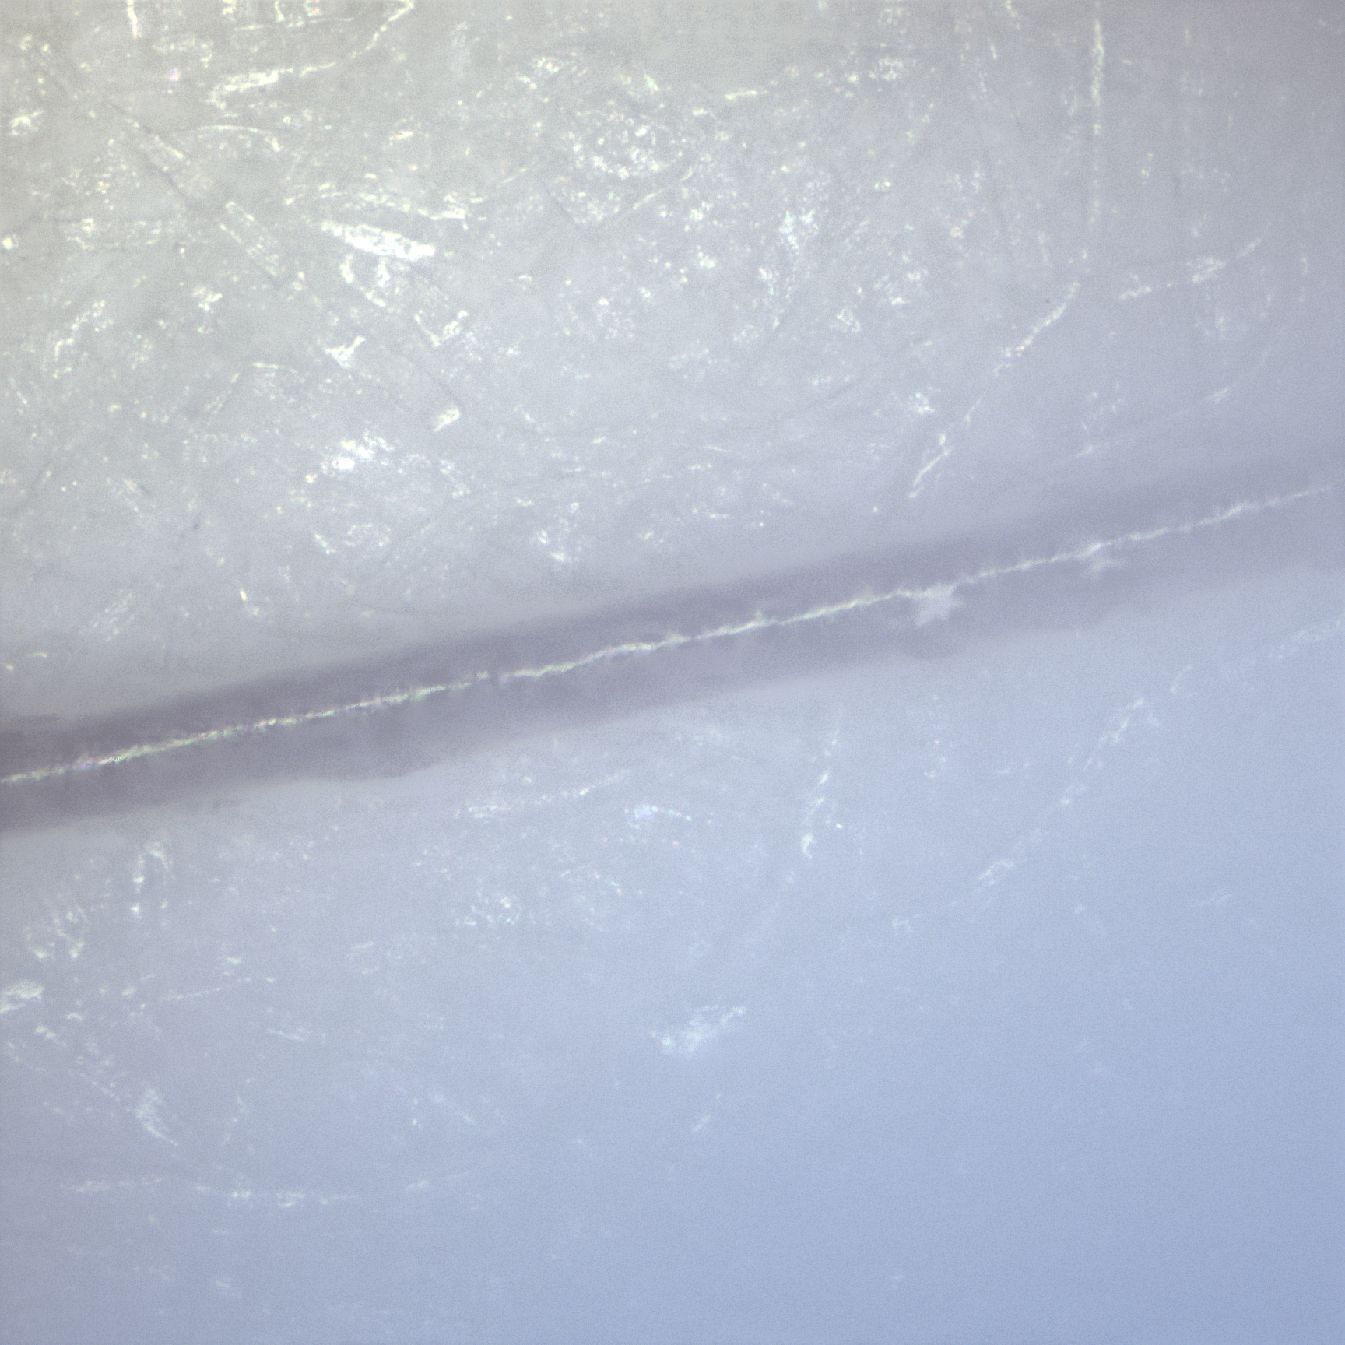
Human hair on paper
The software has combined the 26 images
This is the focus stacked (result) image
Neither the hair nor the paper is blurred.
The paper fibres are visible
This hair is also visible

Slide 26
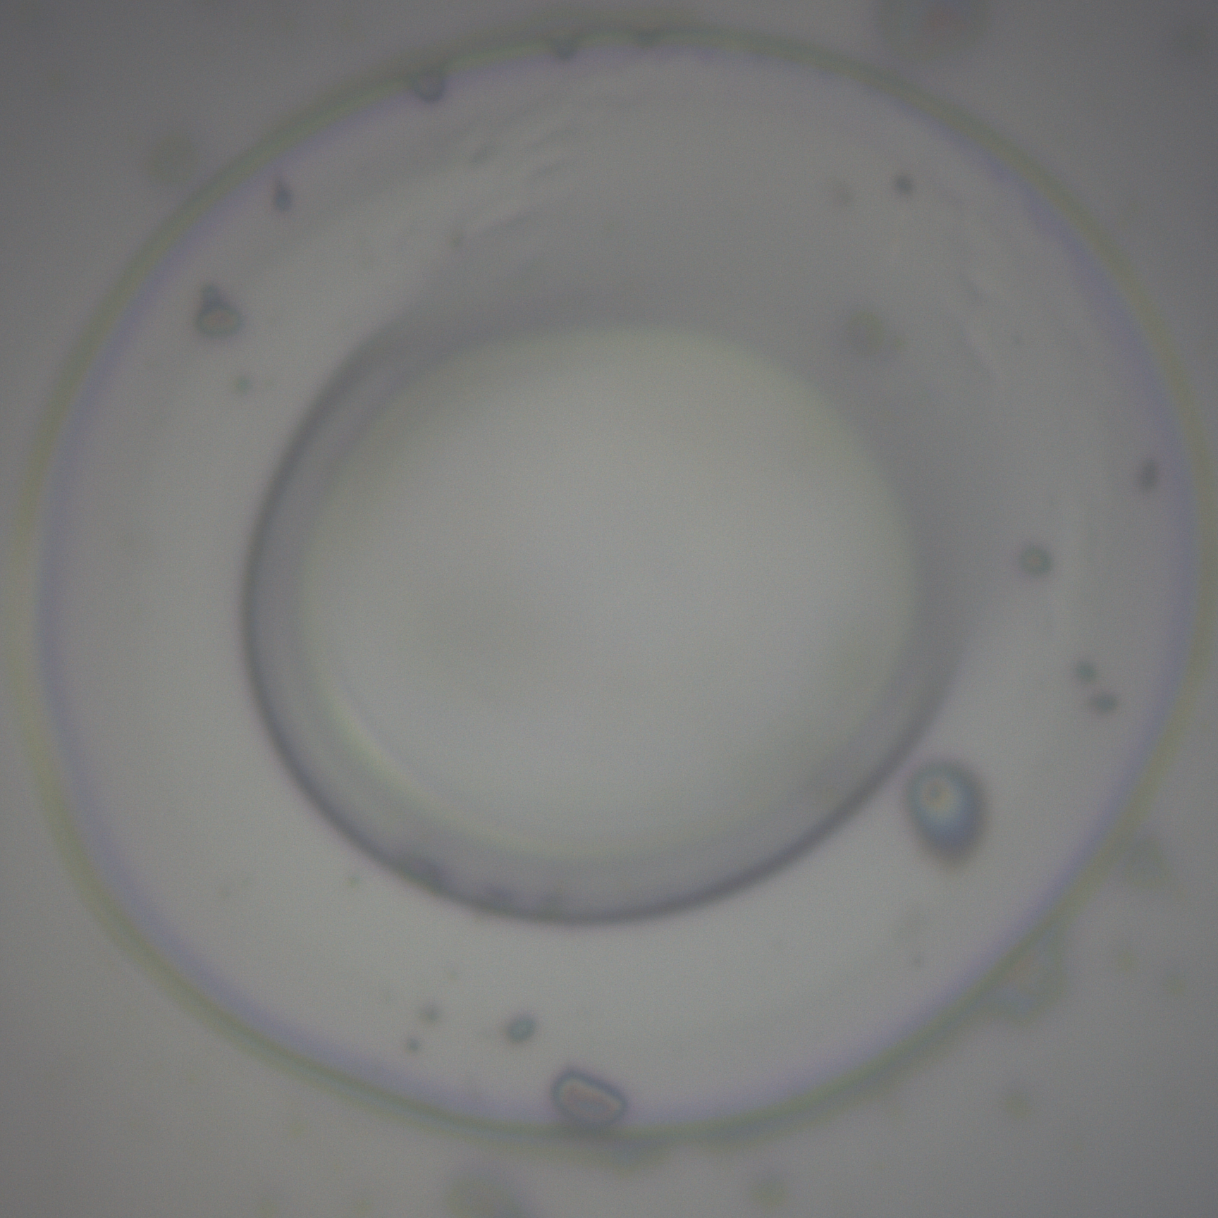
Laser cut hole in Silicon
40x lens
17 steps used, 0.3 μm apart, total distance 5.1 μm
i.e. 18 images captured and used
This image focussed on top of the debris from the hole
The inside of the hole is a blur

Slide 27
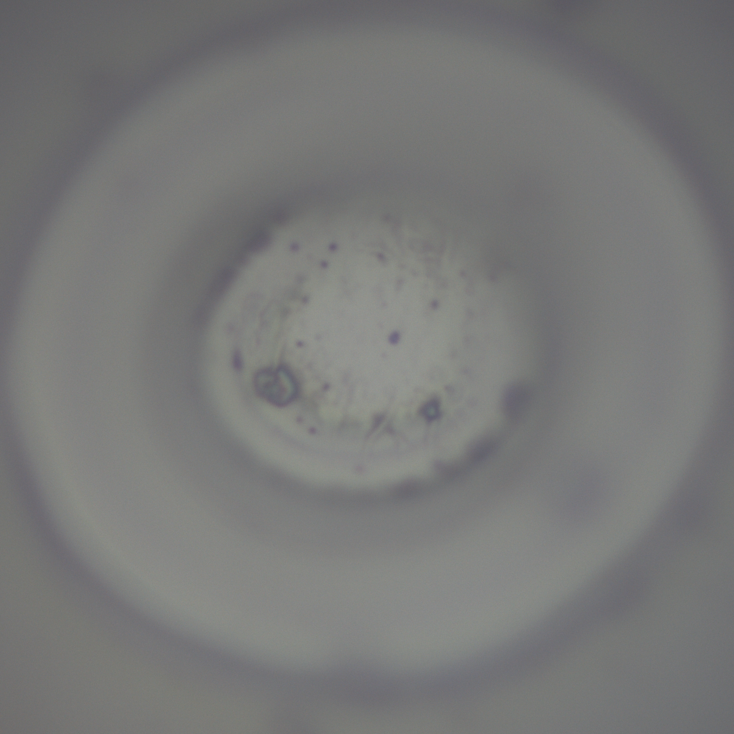
Laser cut hole in Silicon
Same lens, same XY coordinates, different Z coordinate
Another of the 18 images from the Z-stack
This image is focussed inside the hole
The outside of the hole is a blur

Slide 28
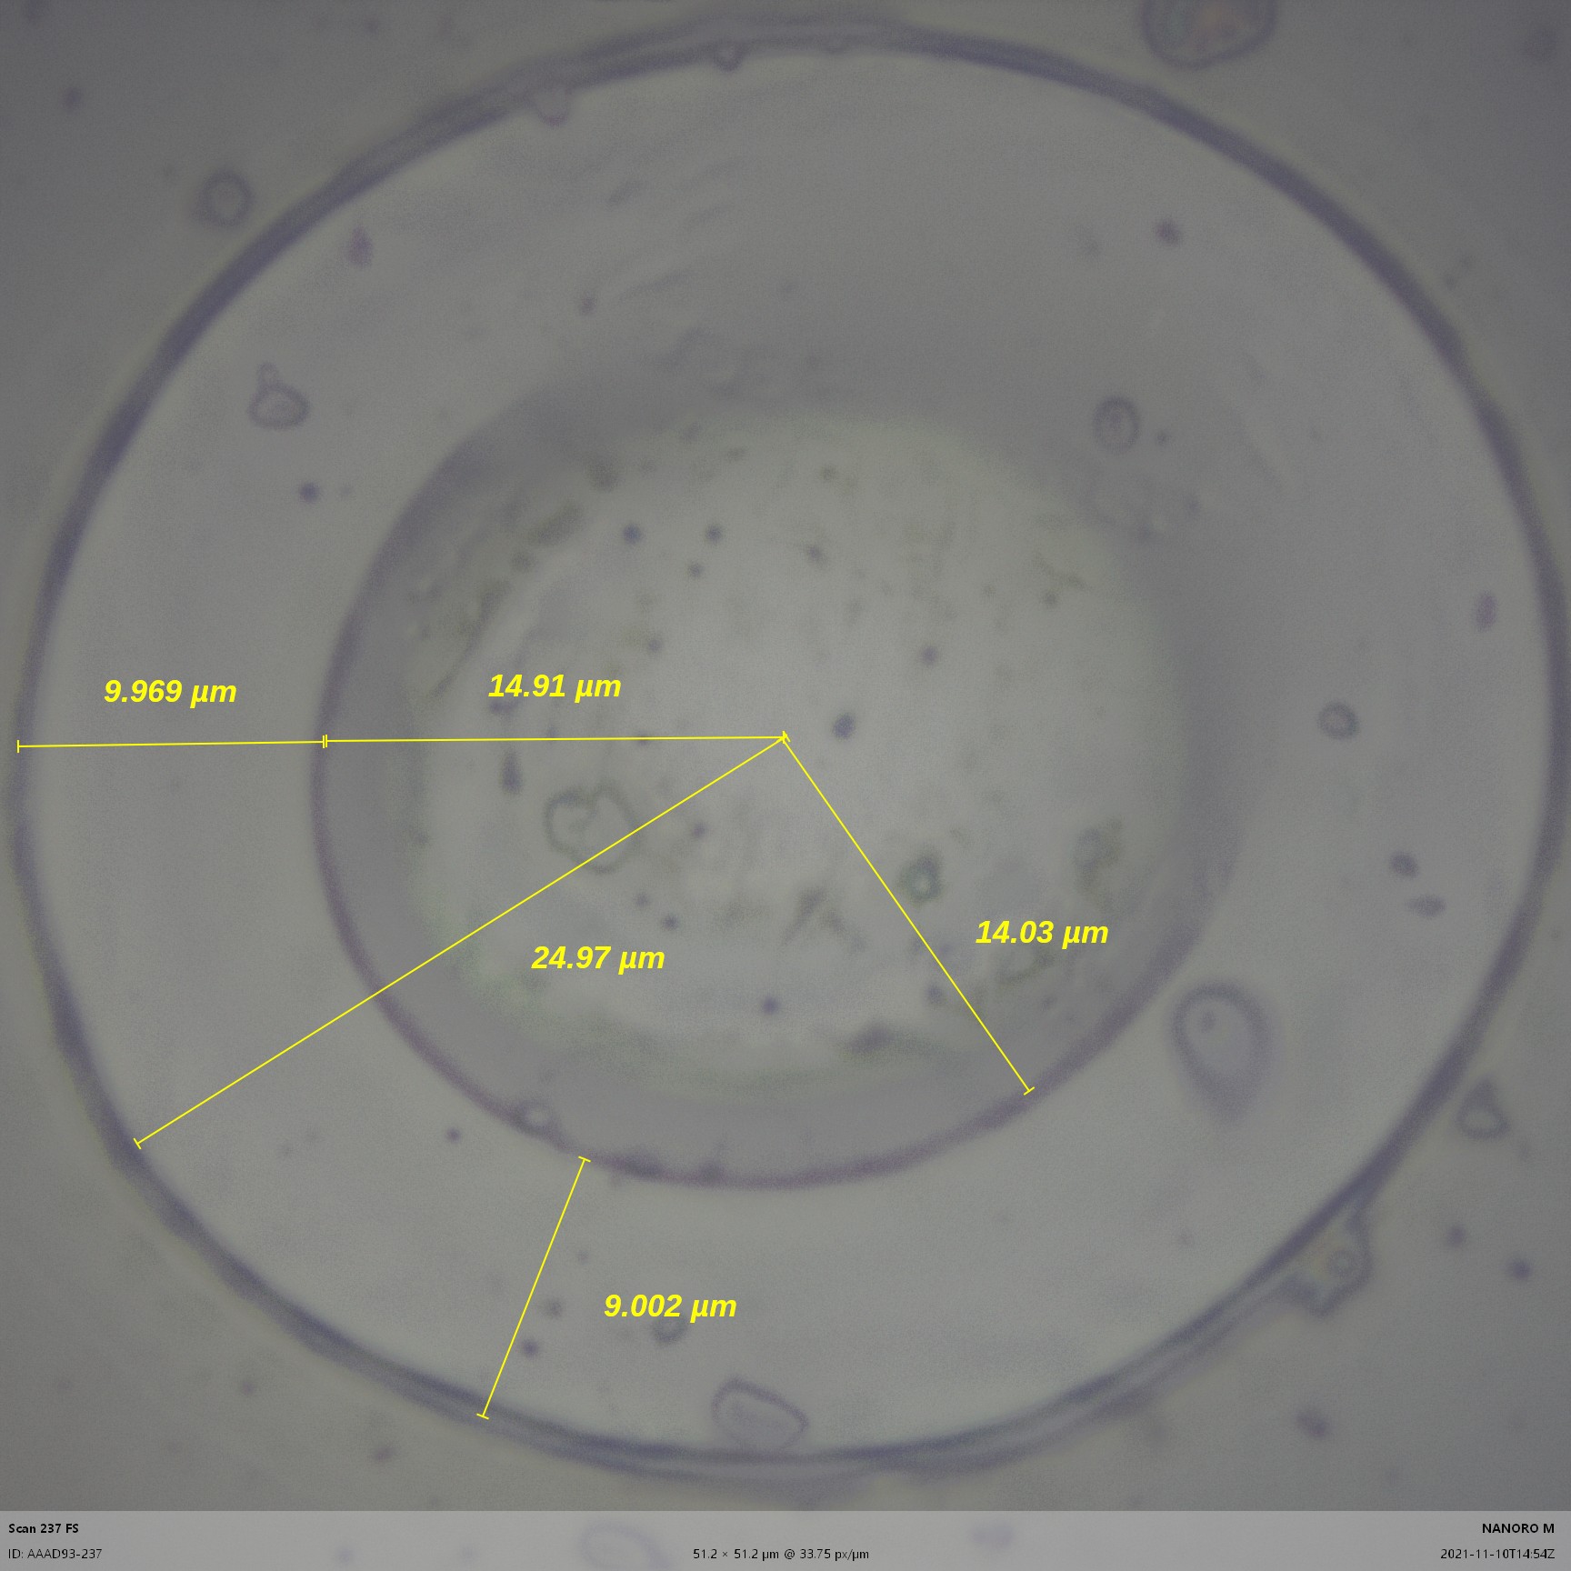
Laser cut hole in Silicon
The software has combined the 18 images
This is the focus stacked (result) image
Neither the inside nor the outside of the hole is blurred.
This image has been annotated with measurements

Slide 29
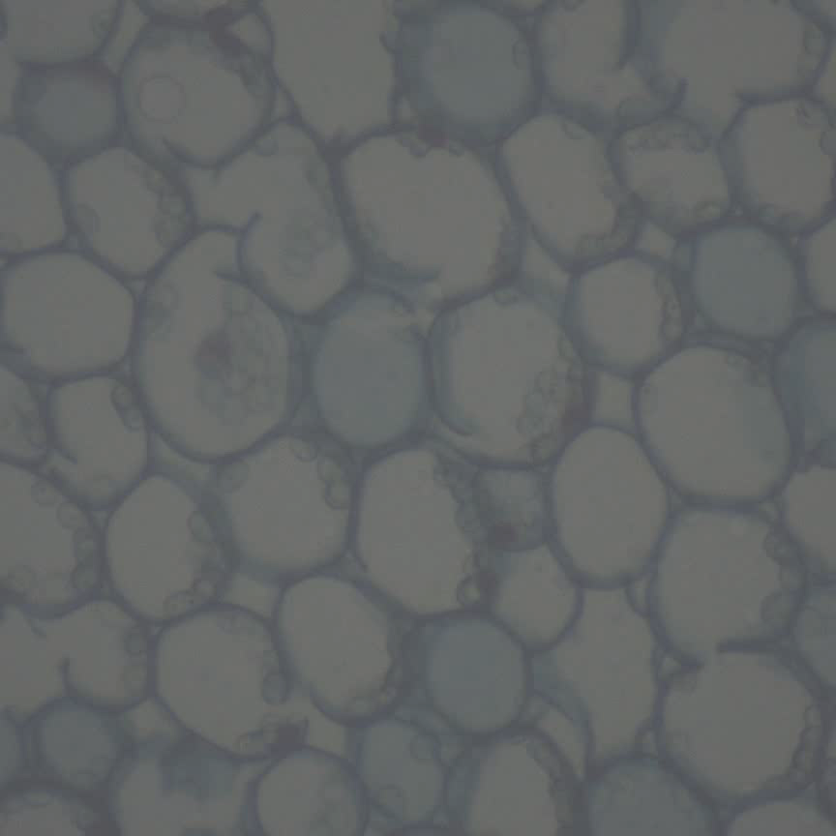
Lilly of the valley cross section of stem
Photo from a mobile phone
Size: Approx 3mm diameter

Slide 30
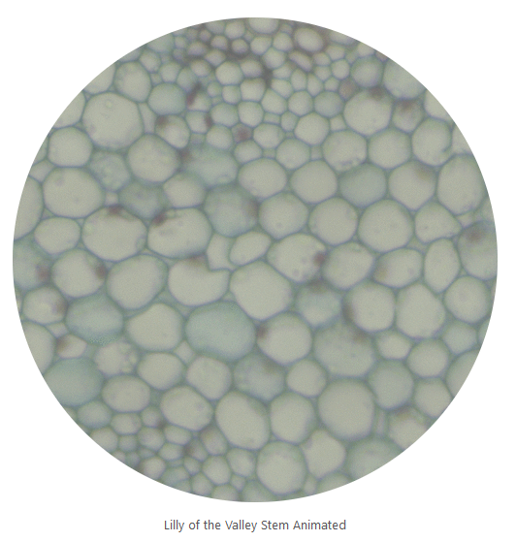
Lilly of the valley cross section of stem
10x lens
Animation zooming on a single cell
GIF File here

Slide 31
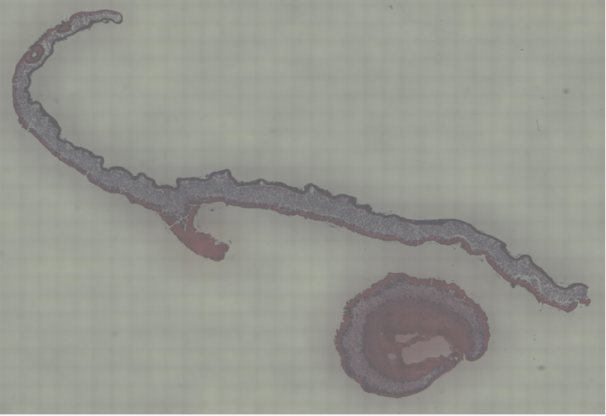
Lichen Thallus
10x lens
Personal familiarisation with looking at bio samples

Slide 32
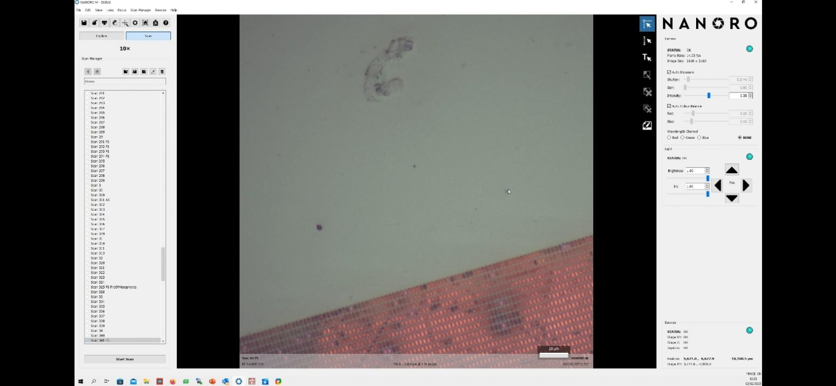
Focus Stacking Video
Video demonstrating focus stacking feature
Shows parameter entry
Shows slice collection
Shows final image
Video: Focus Stacking demonstration

Slide 33
Scale Calibration Video
Video demonstrating manual scale calibration feature
Shows (deliberately) bad measurement and scale bar
Shows image capture
Shows point selection
Shows distance entry
New scale is calculated
Shows correct measurement and scale bar after calibration
Video: Manual Scale Calibration Demonstration From Sample
Video: Using X Displacement

Slide 34
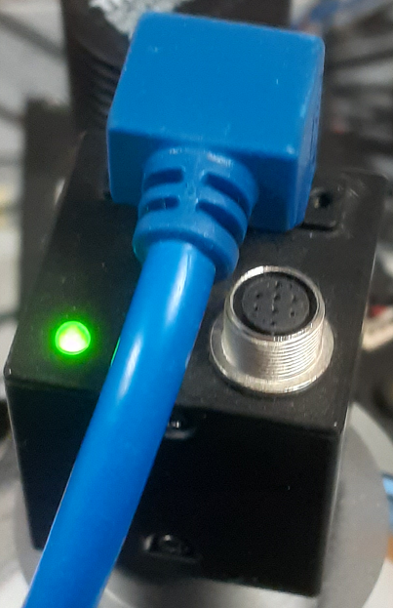
Camera Angle Video
Video demonstrating camera angle calibration feature
Shows image capturing (before and after X axis movement)
Note image moves at an angle due to crooked camera
Camera angle calculated from travel direction in images
Video: Camera Angle Calibration Demonstration

Slide 35
Software Testing Results
VIDEO Generation

Slide 36
1st microscope video
Microscope software created video
Motion added artificially to verify animation,
1 μm added to x coordinate per frame
Sample: Lilly of the valley cells
Videos: Original and resized

Slide 37
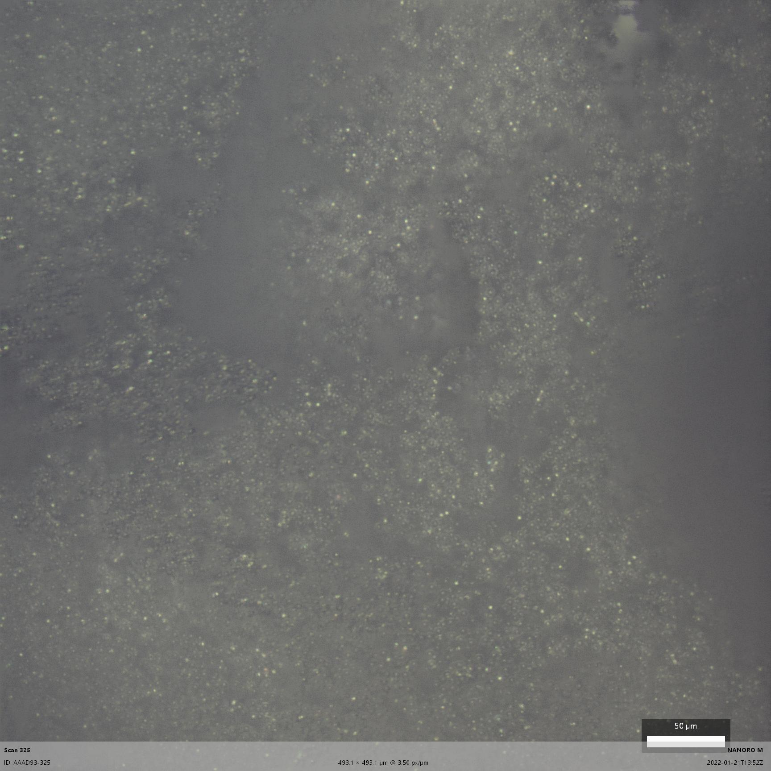
Microspheres
10x lens Focus stacked image
Scale bar ≅ ½ width of human hair
The microspheres, macro-view

Slide 38
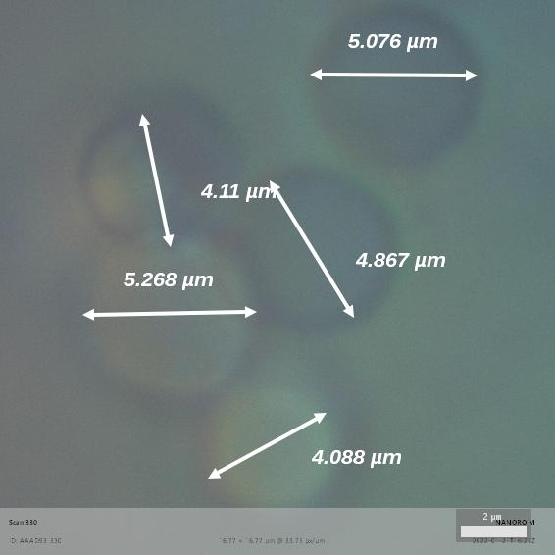
Microsphere size
100x lens
Size measurements

Slide 39
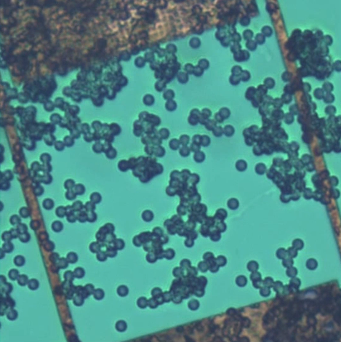
Video Generation testing
Microspheres in oil
Microsphere’s drifting in oil,
used as something moving to test the video generation
5 micron spheres flowing to a stop!
Microsphere collision in oil ripple
A droplet or two added to the oil

Slide 40
Software Documentation
Descriptions of how to use new features

Slide 41
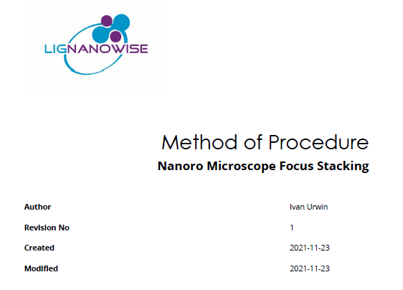
Focus Stacking
Q2: Wrote this
10 pages of instructions for use
Now easily available for inspection
Nanoro Microscope Focus Stacking Procedure
Demonstration Video Available too
Nanoro Microscope Focus stacking demonstration

Slide 42
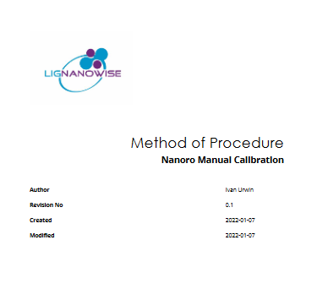
Manual Calibration
Q3: Added this
17 pages of instructions for use
Nanoro Manual Calibration Procedure

Slide 43
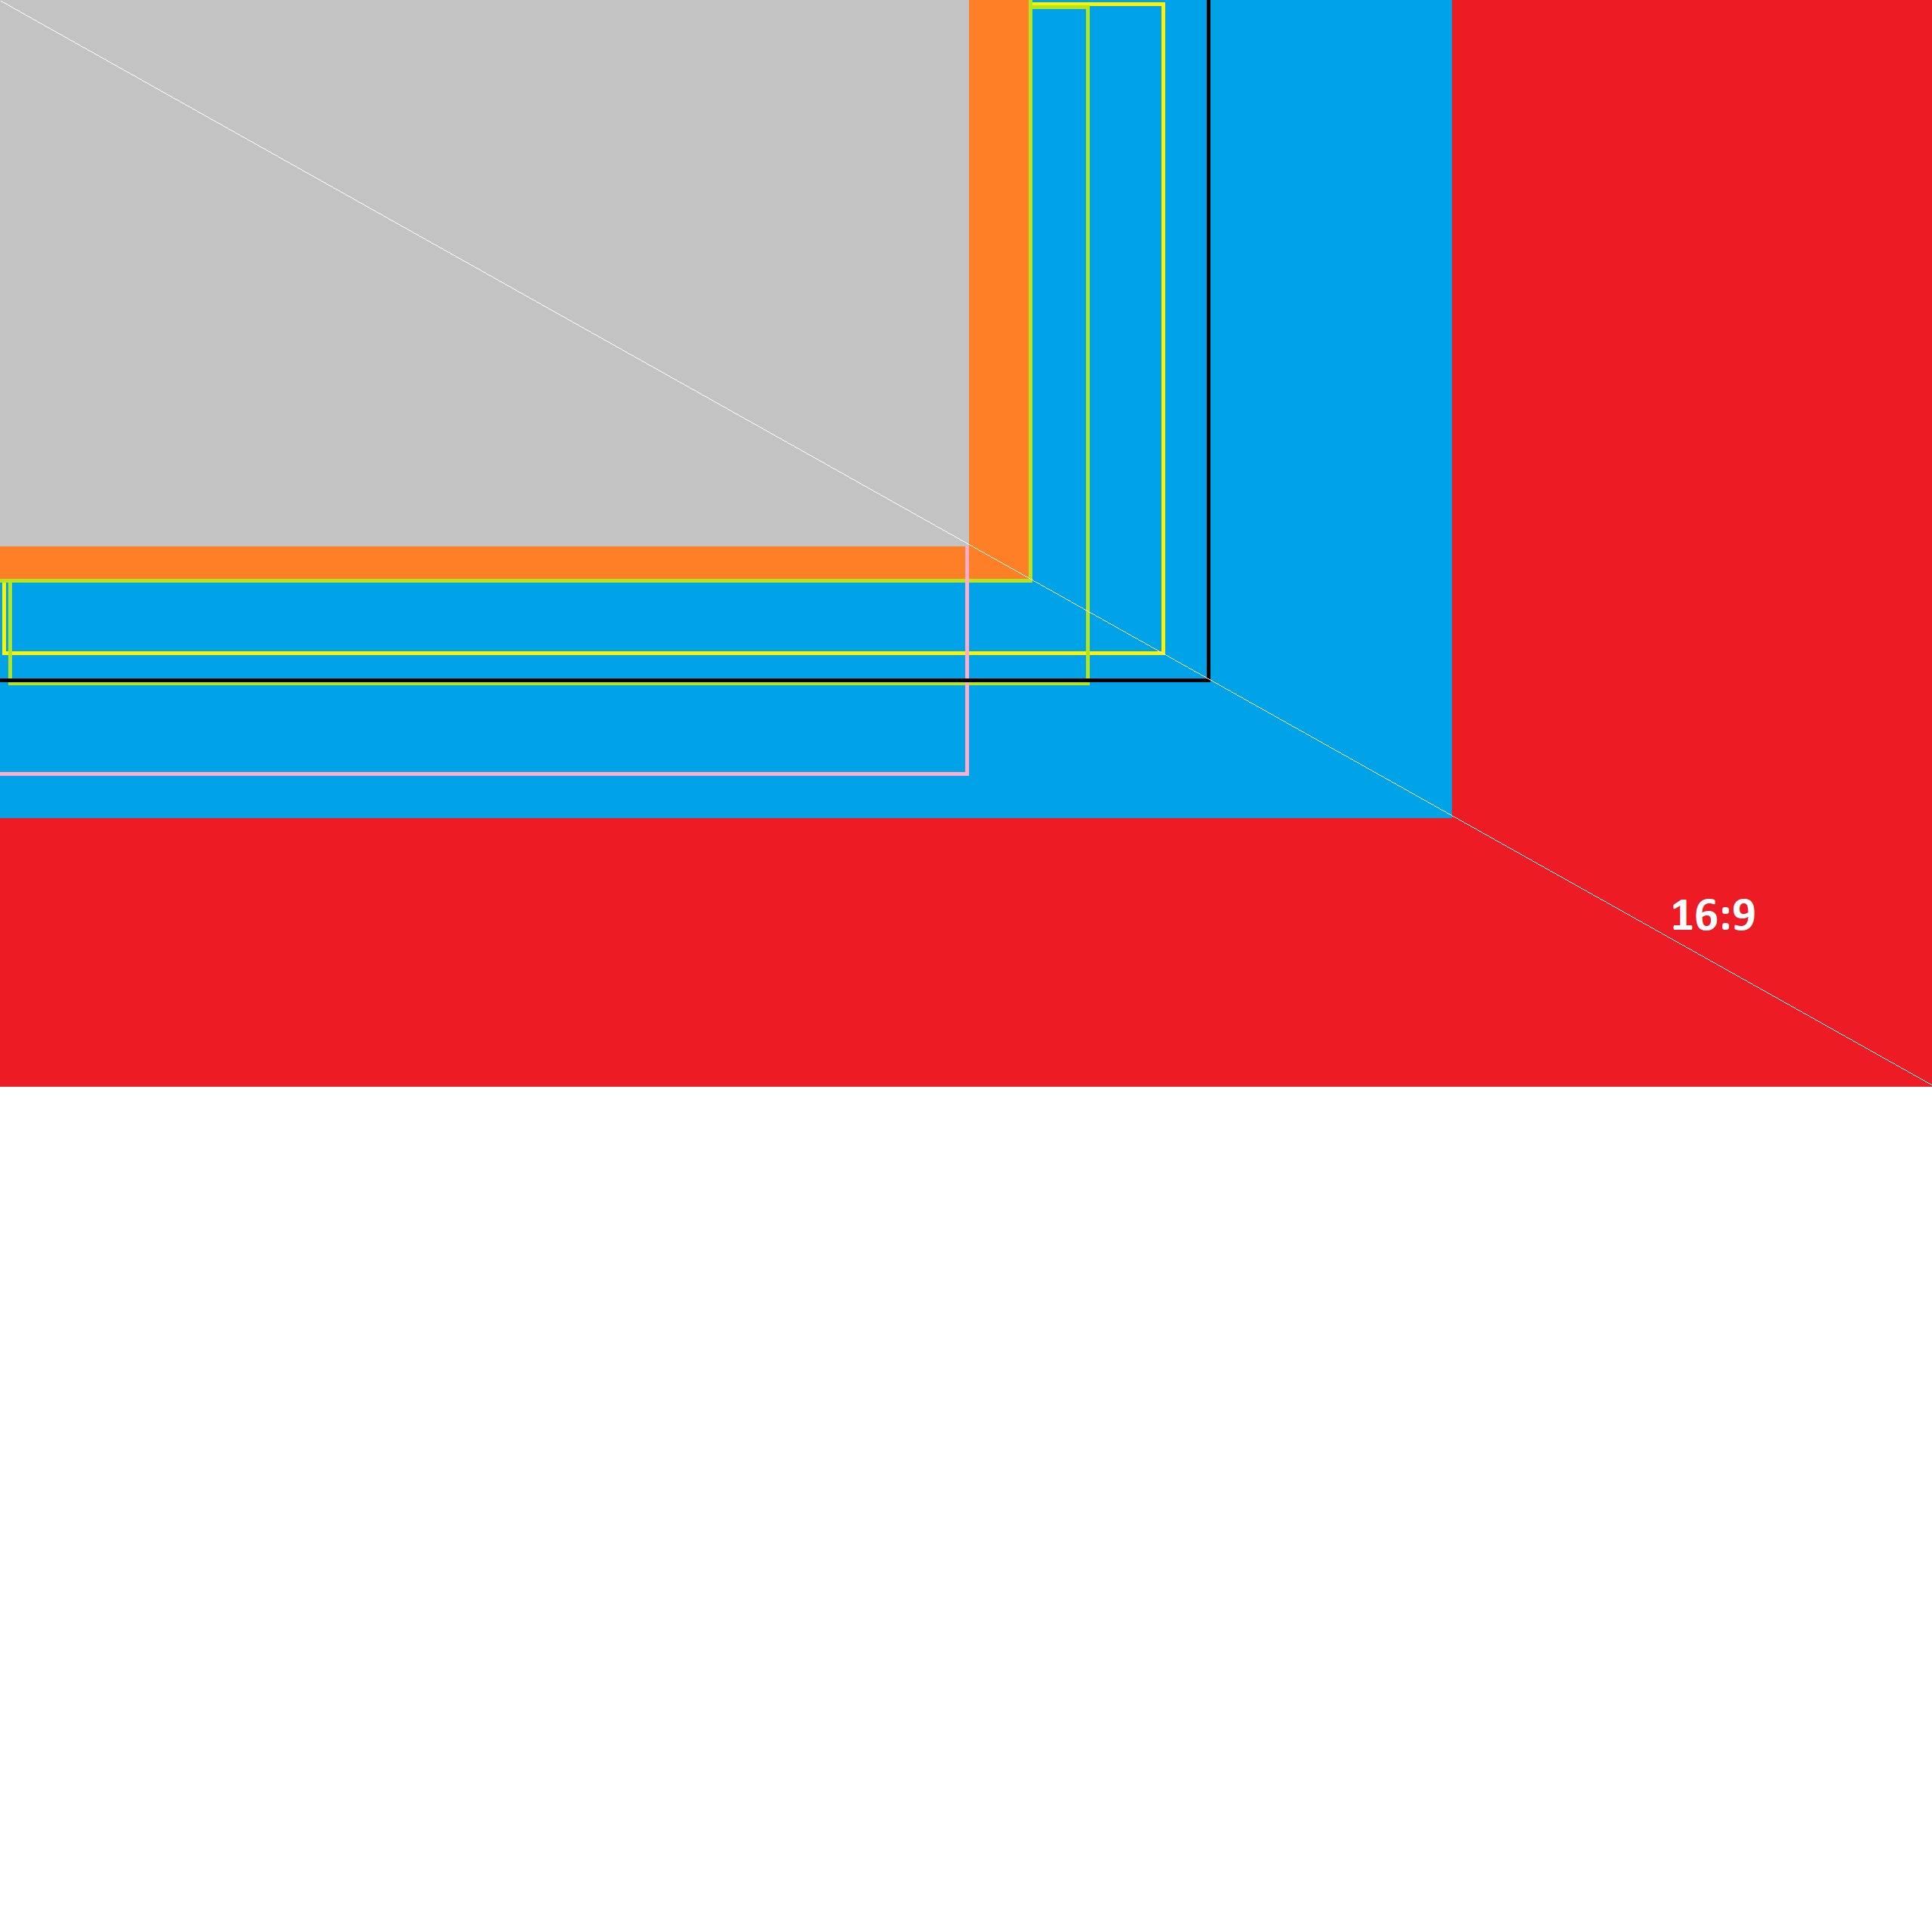

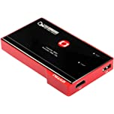
Video Capture Report
Q3
28 pages of analysis of various options
Shown: Standard screen sizes
Versus Nanoro Camera image sizes
Also shown. HDMI Video Capture hardware
Video Capture Report

Slide 44
Software Engineer
Other activites

Slide 45
LV-Mod / NM900
(Light Controller GUI)
Changed the LV-Mod GUI software
It is now called the “Light Controller”
No longer tied to a specific partner
Has its own installer program
Video Demonstration

Slide 46
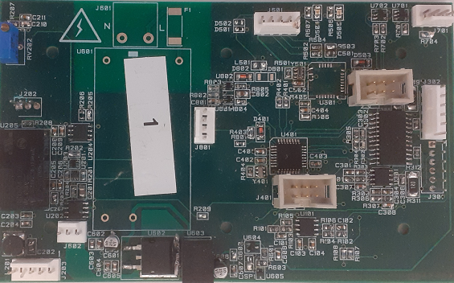
Light Controller PCBs
Helped create a video demonstrating NM900 light unit’s
  Installation
  use
Helped Zagros diagnose issues with manufacture
Reprogrammed a Light Controller card for Microscope
Found cheaper source in China http://www.wmdcircuit.com/

Slide 47
Customer Engagement
Contacted TLM laser/ Oculus
  They are potentially interested in the focus stacking
Wrote a message for my Facebook/LinkedIn
  Cost free, might or might not generate any interest

Slide 48
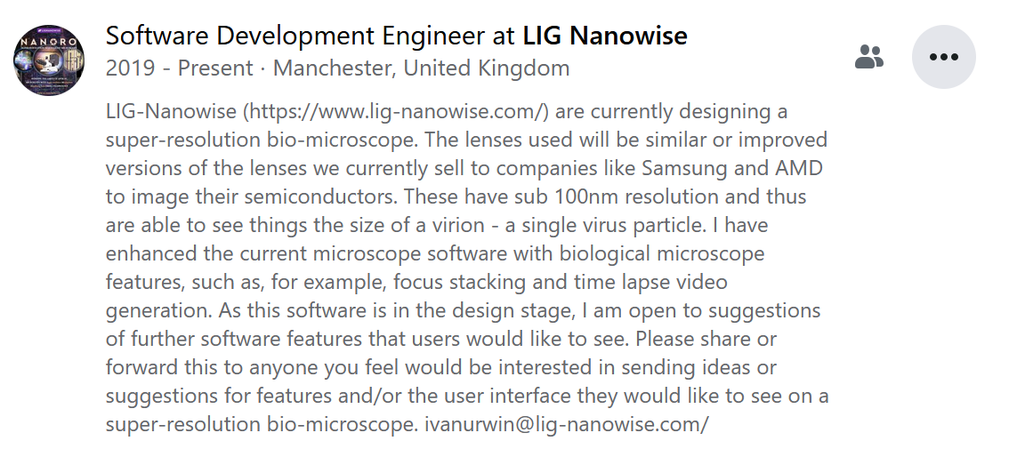
Customer Engagement
Facebook introduction – Ivan Urwin

Slide 49
Customer Engagement
Feedback: Magnification
Feedback from AMD regarding magnification
Software could display the magnification value better
Wrote a short overview of our magnification factor
Details here

